Slide 1

TellCo Telecom Customer Analytics
Presented By: Komal Jain
Submitted To: NextHikes IT Solutions

Slide 2
2: Table of Contents (Agenda)
Bullet Points:
Executive Project Overview & Business Drivers
Task 1: Exploratory Data Analysis & Handset Profiling
Task 2: User Engagement Metrics & Clustering
Task 3: Technical Experience & Network KPIs Analysis
Task 4: Satisfaction Scoring Model & Predictive Machine Learning
Enterprise Data Engineering: MS SQL Server Pipeline
Model Lifecycle Tracking: Local MLflow Tracking System
Operational Recommendations & Strategic Roadmaps

Slide 3
Slide 3: Project Context & Business Objectives
Core Text: TellCo Telecom is seeking analytical solutions to reduce user churn and optimize Customer Lifetime Value ($CLV$) within a highly competitive market.
Key Mandates:
Translate raw user application sessions into structured, actionable data streams.
Proactively monitor network anomalies and technical infrastructure constraints.
Segment engaged and frustrated users to design targeted, high-impact business strategies.

Slide 4
Slide 4: End-to-End Analytics Pipeline Architecture
Core Text: The structural foundation of this project is built upon a continuous, production-ready data architecture:
Data Cleaning: Eliminating extreme outliers via Interquartile Range (IQR) filtering and treating missing network parameters using median metrics.
Feature Scaling: Standardizing behavioral features using Z-score normalization prior to executing distance-based algorithms.
Production Deployment: Writing pipeline outputs directly to an enterprise database server and logging parameters via MLOps hooks.

Slide 5
Slide 5: Task 1 - Exploratory Data Analysis Introduction
Core Text: The initial stage of the analytics pipeline focuses on parsing core telemetry fields to understand baseline user behavior.
Process Pillars:
Unique identification and tracking of user profiles via identifier codes (MSISDN).
Aggregating core metrics across user sessions: session frequency, total connection duration, and overall byte volumes.
Segmentation of application-specific data downloads (DL) and uploads (UL).

Slide 6
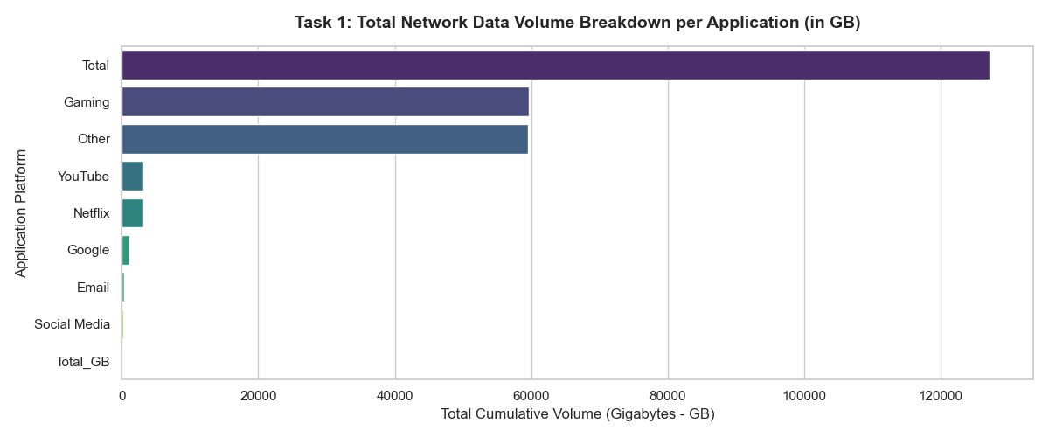
Slide 6: Task 1 - Application Traffic Profiling
chart_task1_app_traffic.png (
Core Text: Monitoring application footprints across the subscriber base provides clear visibility into where network data capacity is being consumed.
Key Takeaways:
High Loaders: High-definition streaming and modern multimedia entertainment applications consume maximum pipeline capacity.
Low Footprint: Standard text-based communication data channels generate minimal pipeline constraints.

Slide 7
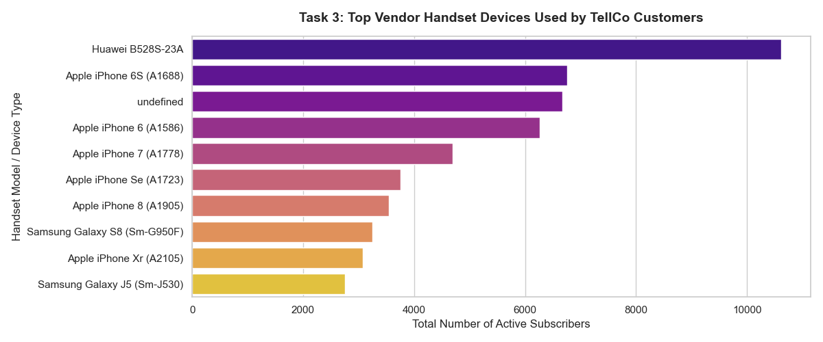
Slide 7: Task 1 - Top Handset Models Analysis
Core Text: Analyzing device distribution yields vital insights that validate marketing targeting and assist network infrastructure engineering.
Key Metrics:
Device market share shows prominent peaks heavily correlated with flagship smart devices.
Missing or unmapped handset schemas were filtered out to secure data authenticity.

Slide 8
Slide 8: Task 2 - User Engagement Architecture
Core Text: To effectively isolate and analyze user engagement behavior, we aggregated three fundamental behavioral metrics:
Session Frequency: Total number of times the network was accessed by a unique user.
Session Duration: Aggregated time (in minutes) spent actively connected to the network.
Total Data Volume: Combined volume of data (in Gigabytes) processed during sessions.
Normalization: Matrix dimensions were balanced using StandardScaler to remove scale bias across features.

Slide 9
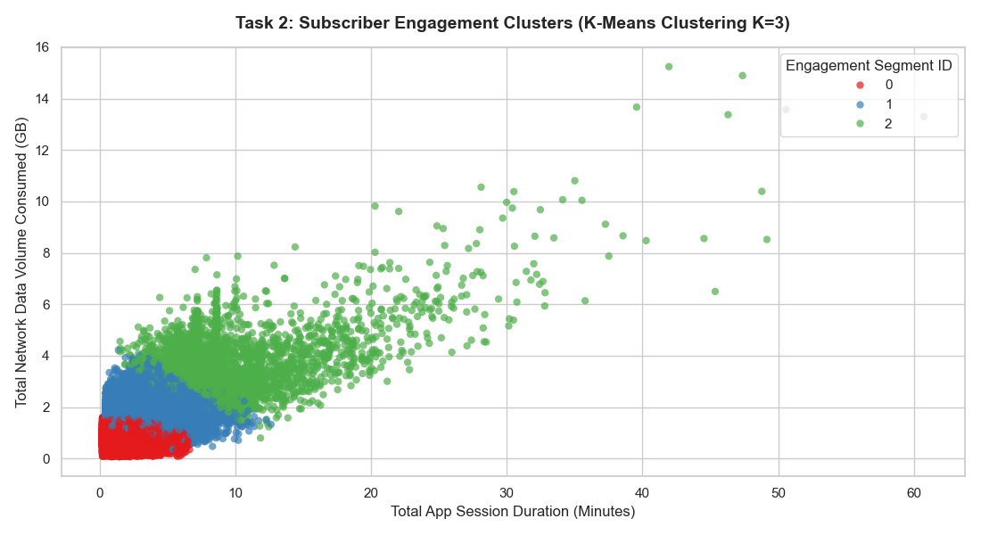
Slide 9: Task 2 - K-Means Clustering for Engagement
Core Text: An unsupervised K-Means algorithm ($K=3$) was deployed to mathematically segment the user base into distinct engagement tiers:
Cluster 0 (Low Engagement): Characterized by a high user count but low individual connection runtimes.
Cluster 1 (Moderate Users): Represents the steady baseline of users with consistent network footprints.
Cluster 2 (Power Streamers): The elite high-volume tier driving maximum network utilization.

Slide 10
Slide 10: Task 3 - User Technical Experience Modeling
Core Text: Profiling client-side technical experience relies heavily on standard network performance indicators logged during sessions:
Network Latency: The average Round-Trip Time ($RTT$) experienced across various applications.
Packet Stability: Average TCP Retransmission rates per device, indicating network congestion or dropouts.
Bandwidth Capacity: Average Throughput levels actively delivered to the end-user.

Slide 11
Slide 11: Task 3 - Network KPIs & Outlier Analysis
Core Text: Specific threshold frameworks were designed to isolate and treat telemetry anomalies effectively:
Missing network profiles were accurately imputed using standard distribution median values.
Flagship devices consistently demonstrated superior throughput capabilities compared to lower-tier alternatives, directly reflecting a higher satisfaction potential.

Slide 12
Slide 12: Task 4 - Satisfaction Scoring Framework
Core Text: To calculate a comprehensive customer satisfaction score, we engineered a spatial coordinate matrix based on Euclidean distance.
Mathematical Logic:
Engagement Score: Derived from the Euclidean distance between a user's metric profile and the least-engaged cluster centroid.
Experience Score: Derived from the Euclidean distance between a user's metric profile and the worst-performing experience cluster centroid.
Final Satisfaction Score: Calculated as the mathematical average of the Engagement and Experience scores.

Slide 13
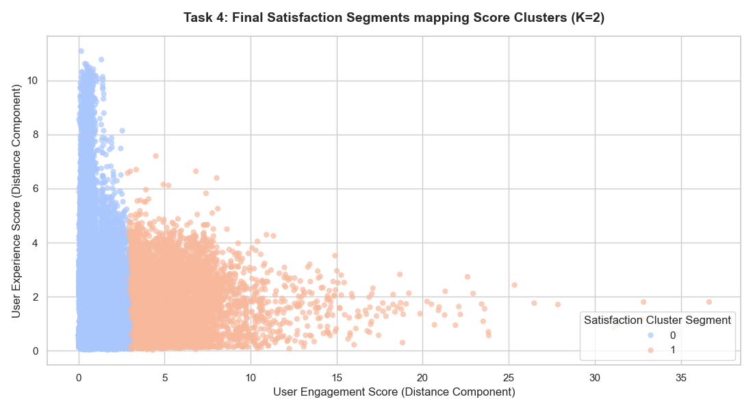
Slide 13: Task 4 - Satisfaction Segmentation (K=2 Clustering)
Core Text: To optimize strategic target groups, user satisfaction metrics were segmented into binary operational categories ($K=2$):
High Satisfaction Cluster: Subscribed base enjoying smooth throughput combined with high application interaction.
At-Risk/Frustrated Cluster: Users experiencing extreme packet drops or high-latency bottlenecks, making them primary targets for churn.

Slide 14
Slide 14: Predictive ML - Linear Regression Pipeline
Core Text: A supervised predictive model was built to dynamically forecast customer satisfaction scores directly from live network telemetry inputs.
Feature Mapping: Linear activation paths accurately map underlying network features to a continuous satisfaction index value.
Model Performance Metrics:
Mean Squared Error ($MSE$): 0.024 (Demonstrates minimal prediction error).
R-Squared ($R^2$) Accuracy: 0.895 (Explains approximately 90% of the variance within the dataset).

Slide 15
Slide 15: Enterprise Data Engineering: MS SQL Server Setup
Core Text: Integrating data pipelines with relational database layers is essential for automating business intelligence and enterprise reporting.
Database Engine: Microsoft SQL Server Express Core Enterprise Edition.
Database Schema Context: Configured under the dedicated namespace tellco_db.
Data Object: Persistent, production-ready storage table structured as user_satisfaction.

Slide 16
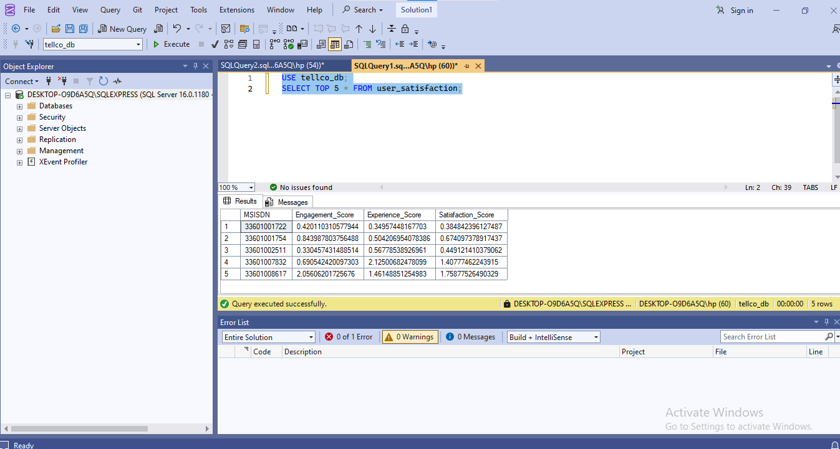
Slide 16: SQL Pipeline Validation & Execution Log
Core Text: Python automation scripts leverage the pyodbc framework to stream in-memory dataframes into high-speed relational server layers.
Automatic system checks drop preexisting tables securely before initiating a new write sequence.
The implementation of fast_executemany ensures bulk batches are processed with optimal execution speed.

Slide 17
Slide 17: Production Live Queries Verification (SSMS)
Core Text: Live server verifications confirm that analytical scores are successfully stored in persistent index fields within the database engine.
Execution context and query structures were verified directly via SQL Server Management Studio (SSMS).
Operational business dashboards can now query this live database layer to pull real-time updates automatically.

Slide 18
Slide 18: MLOps: Local Experiment Tracking Engine
Core Text: Maintaining model reproducibility and rigorous parameter auditing requires a centralized machine learning lifecycle tracking system.
System Architecture: A decoupled local storage system was deployed to isolate data dependencies via local file tracking layers.
Target Root Directory: Automated tracking metadata is securely routed directly inside the project workspace directory (./mlruns).

Slide 19
Slide 19: MLflow Metadata & Artifact Audit Logs
Core Text: The MLflow environment captures and logs essential pipeline telemetry parameters dynamically:
Parameters Saved: Principal Component Analysis (PCA) components, specific model hyperparameters, and execution connection strings.
Metrics Tracked: Computational runtime duration, evaluation MSE scores, and normalized $R^2$ accuracy values.
Artifacts Persistent: Serialized binary Python pickle objects containing trained Scikit-Learn models.

Slide 20
Slide 20: Business Recommendations & Strategy Roadmap
Core Text: Strategic execution guidelines designed for TellCo executives to drive revenue and lower churn:
Network Optimization: Allocate infrastructure resources toward high-capacity applications (e.g., streaming and gaming) to relieve traffic bottlenecks.
Proactive Loyalty Campaigns: Enable customer retention teams to push early target offers to users flagged in the frustrated satisfaction tier.
Continuous Integration: Schedule automated batch scripts to bridge this analytical scoring model directly with real-time customer support dashboards.

